Slide 1

Precipitation and Rising air Temperatures in Connecticut
Kevin O’Donnell

Slide 2
Introduction + Goals
Background – climate change has been said to increase the frequency and intensity of extreme weather events
My goal – see if this holds true in Connecticut for precipitation
Question 1: Have air temperatures increased?
Question 2: Are days with very high or low levels of precipitation becoming more common?
Question 3: Is there a link between these two phenomenon?

Slide 3
Data + Terminology
8 stations from 8 different counties in Connecticut
Daily records of high, low, precipitation, along with location data
Extreme precipitation events = day where precipitation total > 2 standard deviations from mean for that year
Measuring change in air temperature by yearly average high and low temperatures

Slide 4
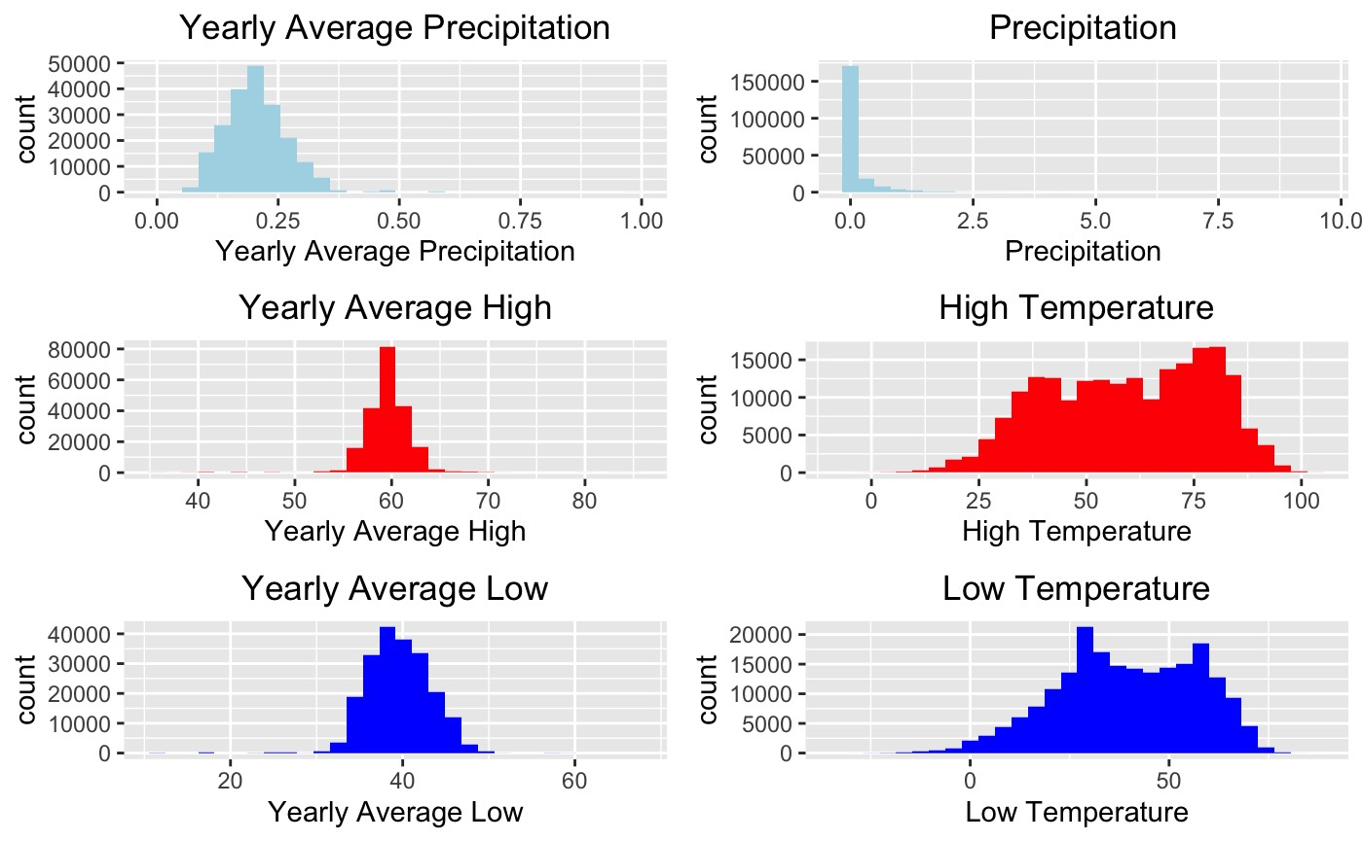
Single Variable Distributions

Slide 5
Q1: Have air temperatures increased in Connecticut since 1900?

Slide 6
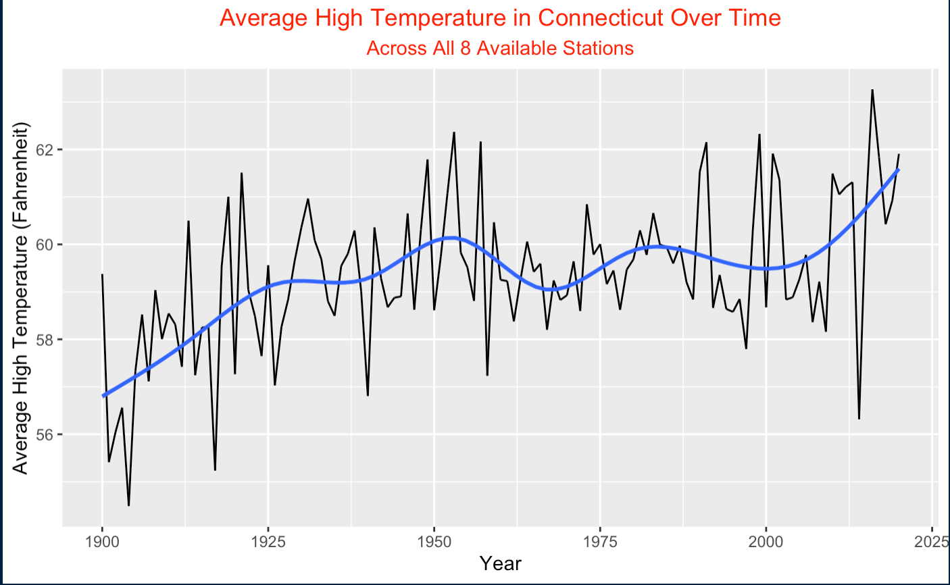
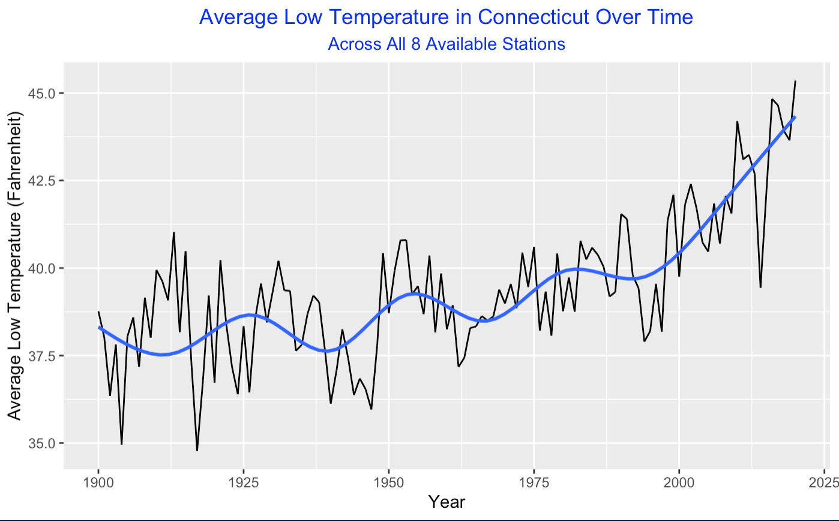
Average High + Low Temps Over Time

Slide 7
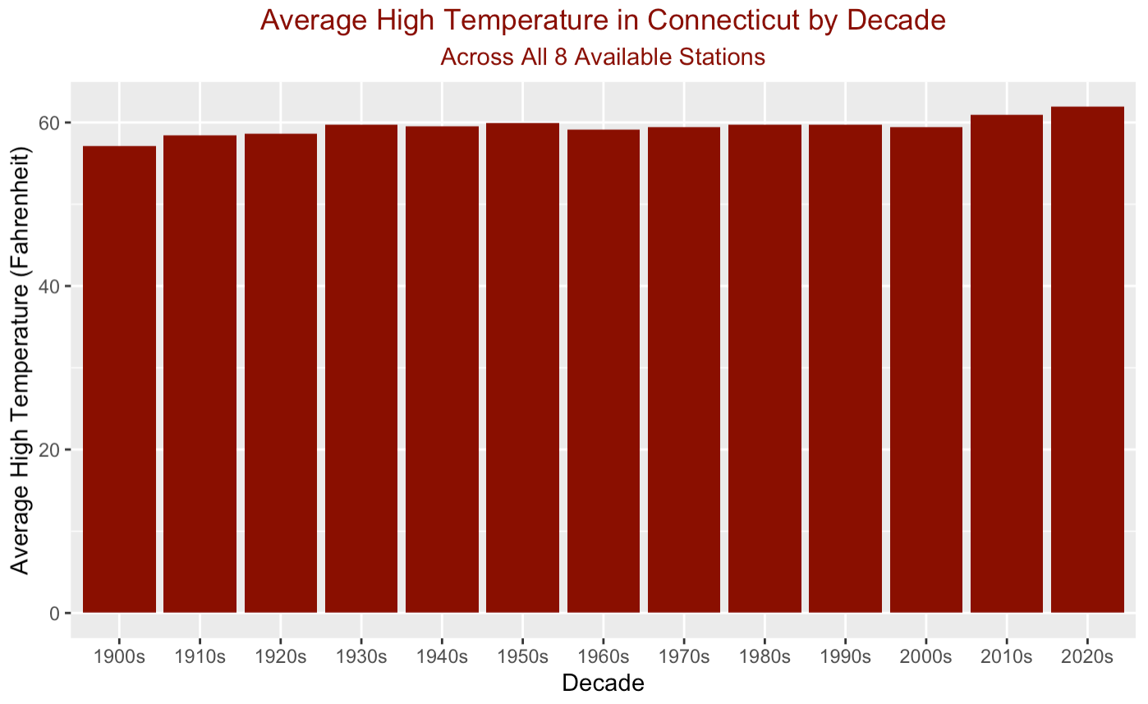
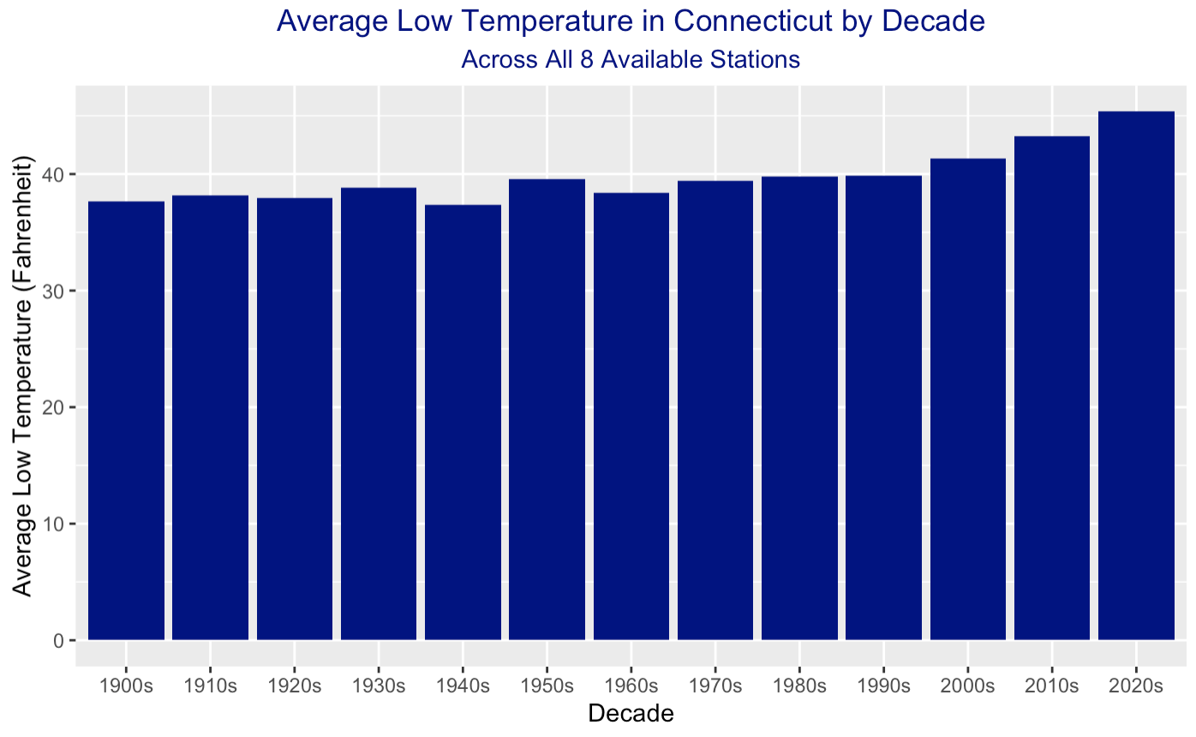
Average High + Low Temps By Decade

Slide 8
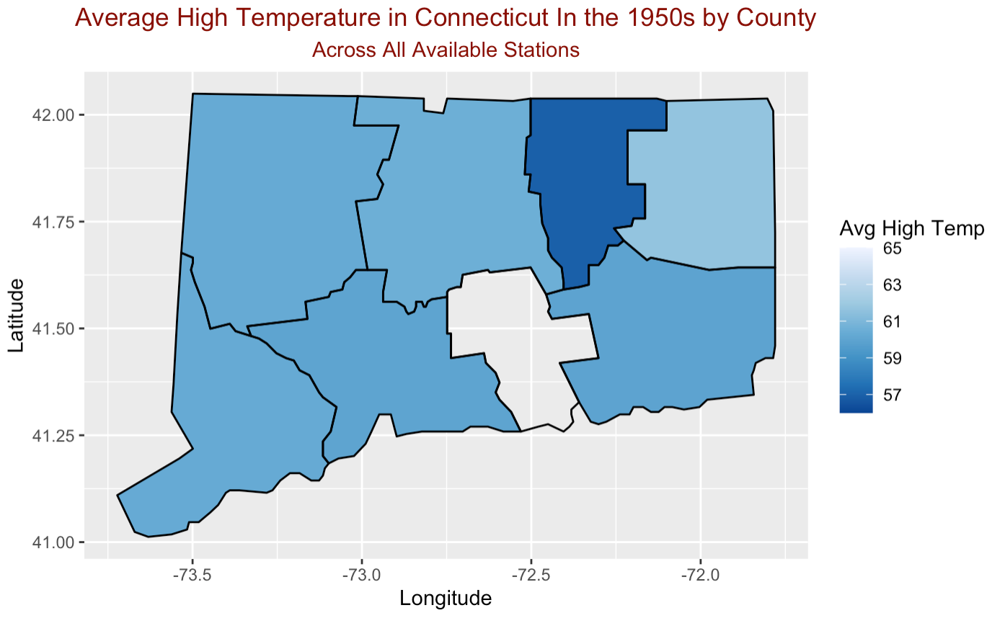
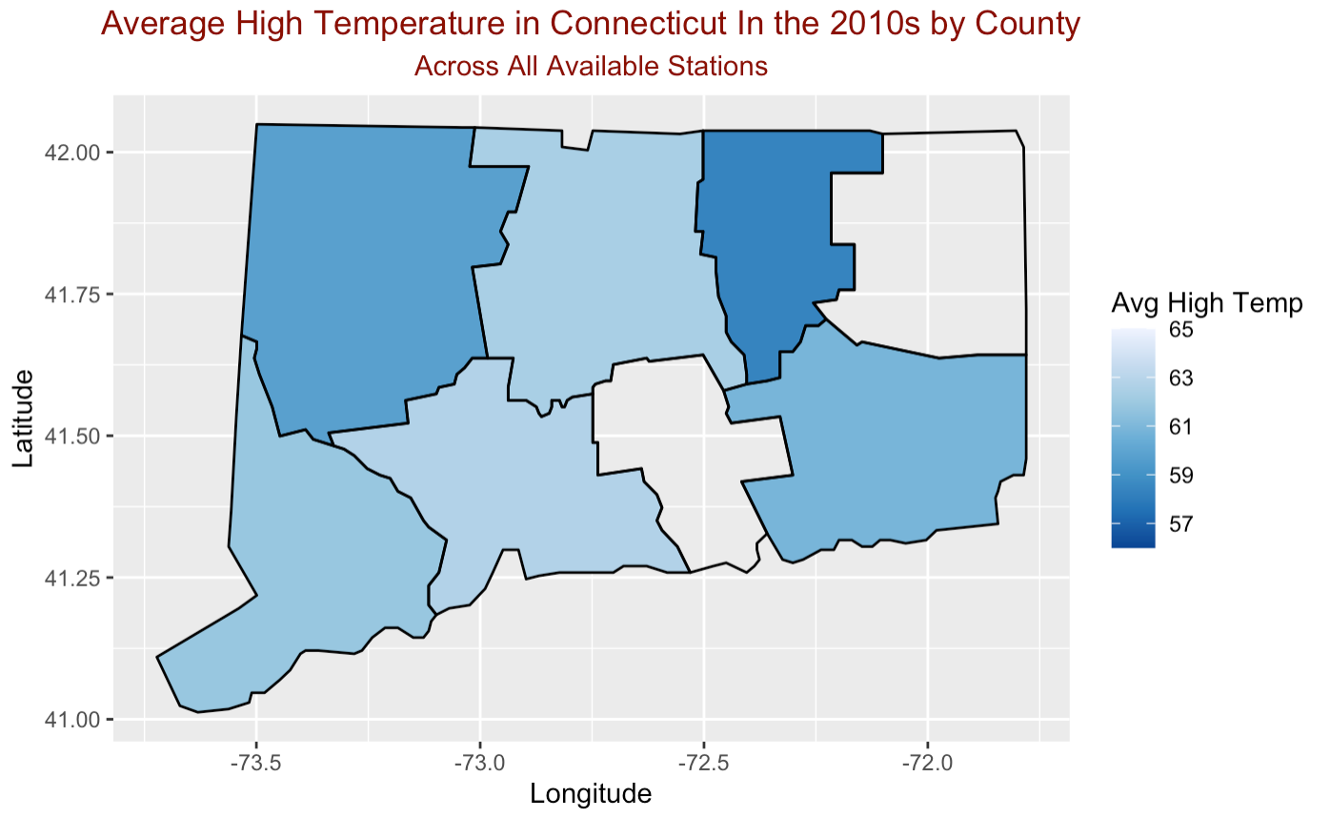
Average High Temps By Decade

Slide 9
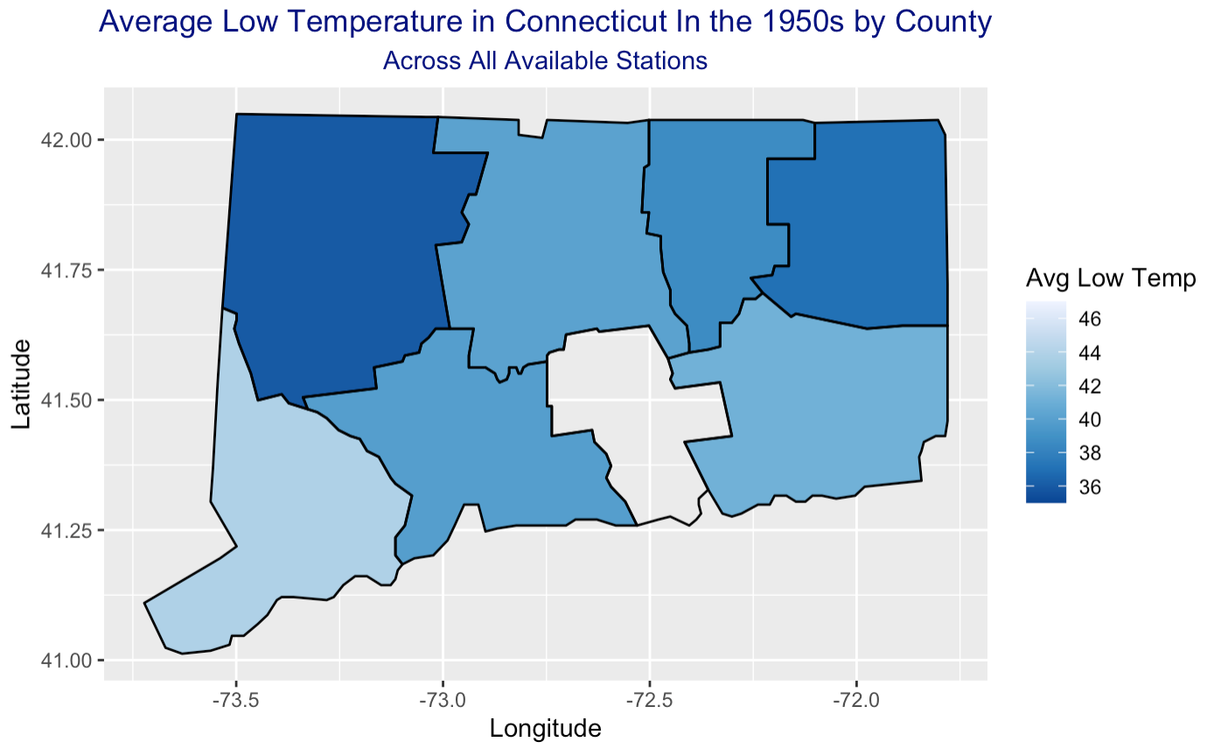
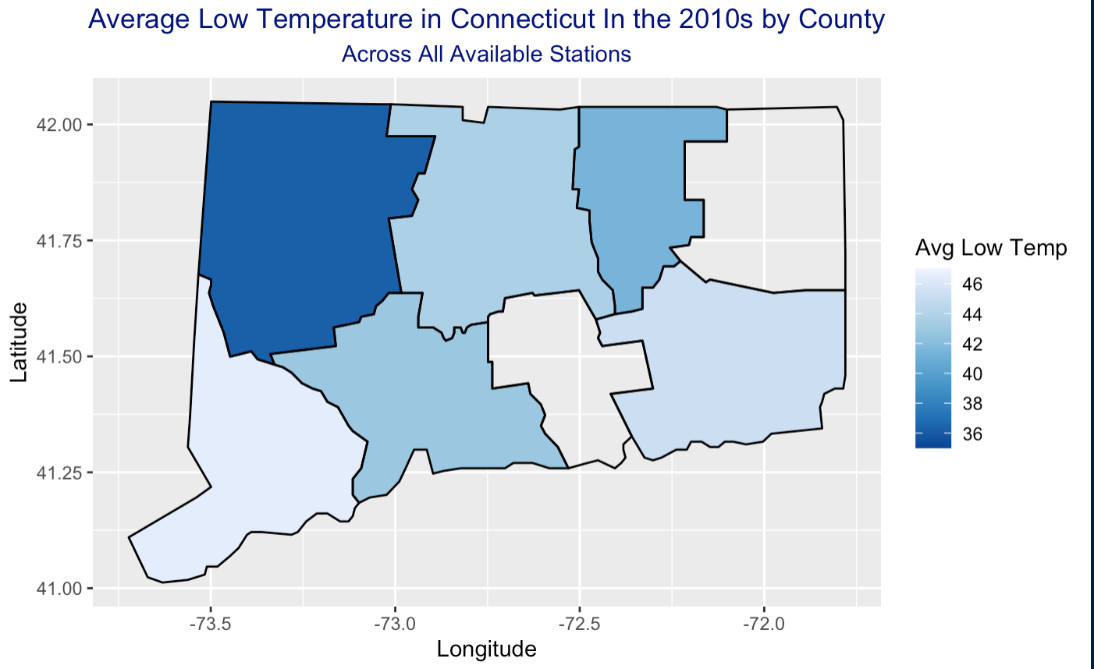
Average Low Temps By Decade

Slide 10
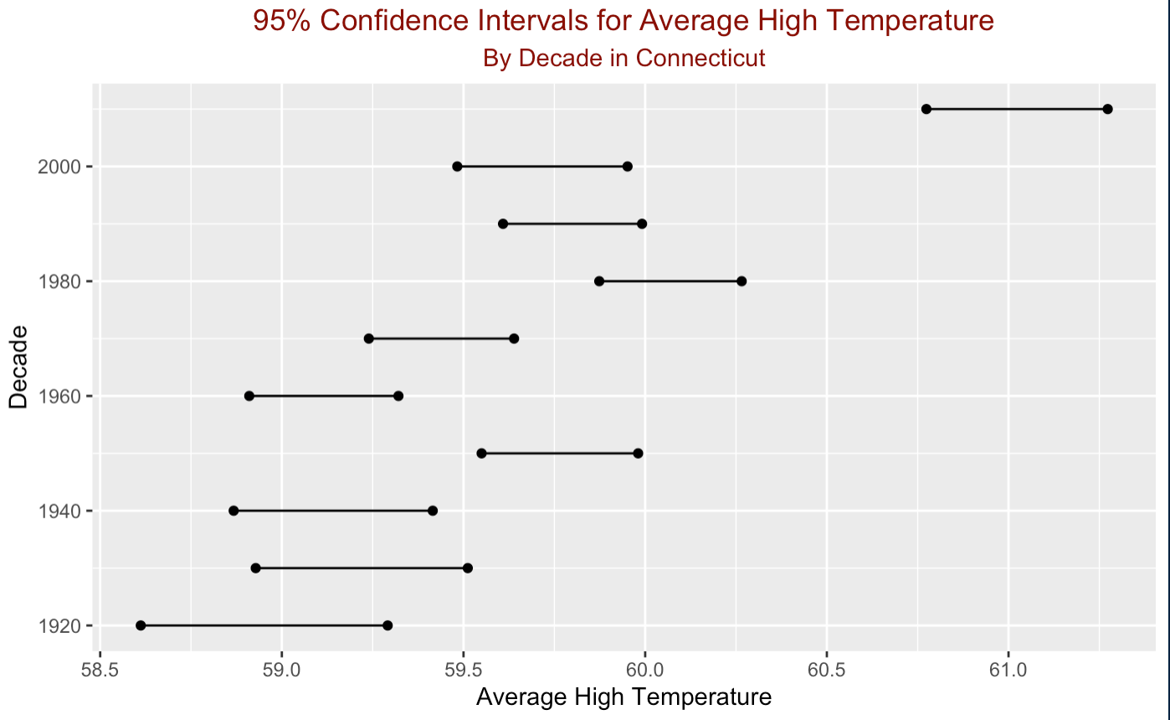
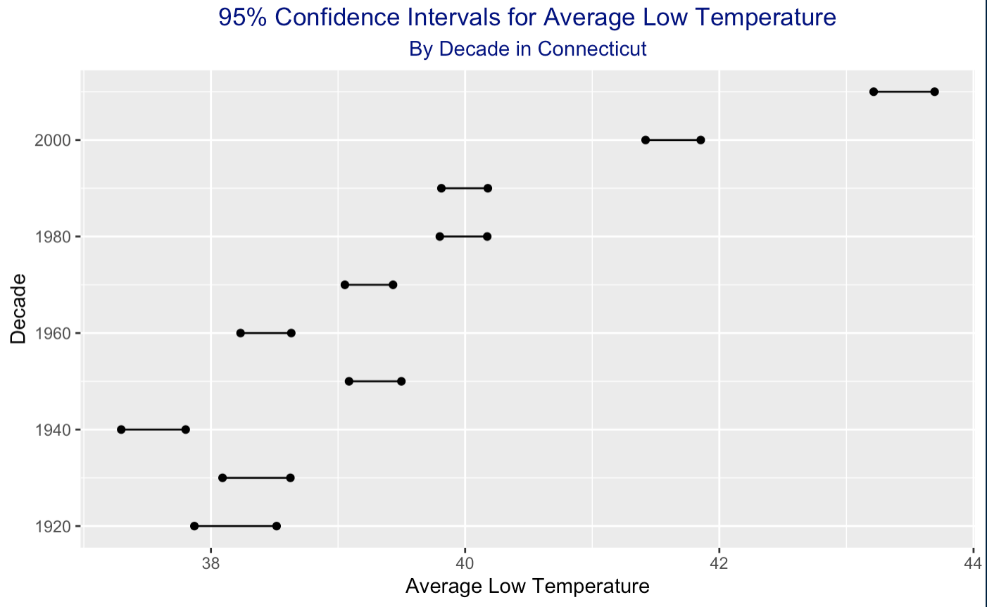
Confidence Interval for Average High + Low

Slide 11
Q2: Are days with very high or low levels of precipitation becoming more common?

Slide 12
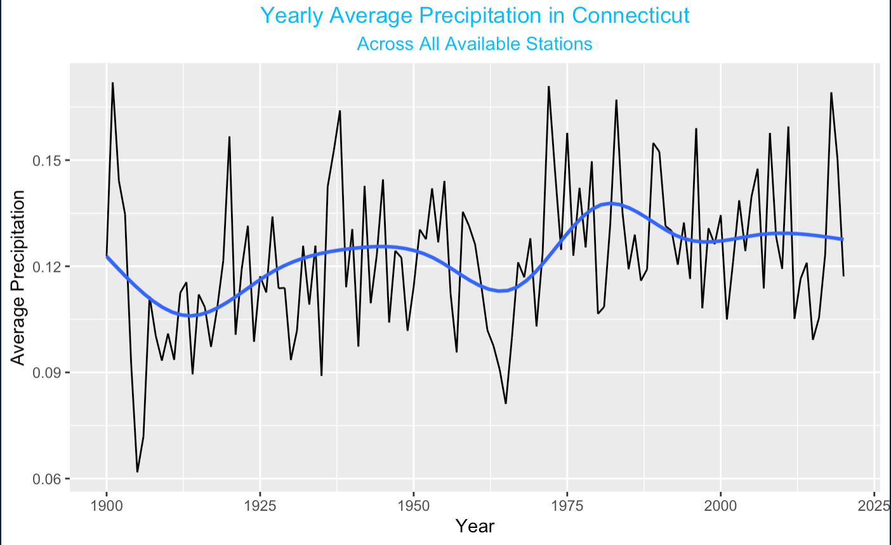
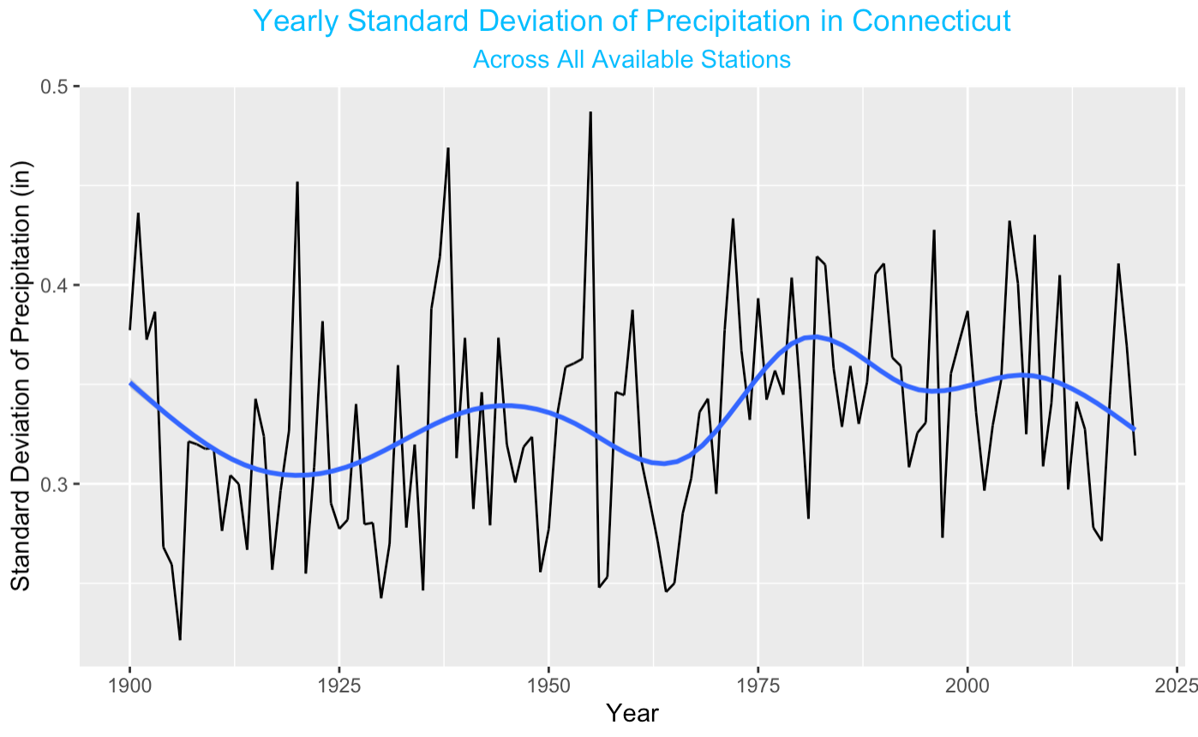
Average and Variation of precipitation over time

Slide 13
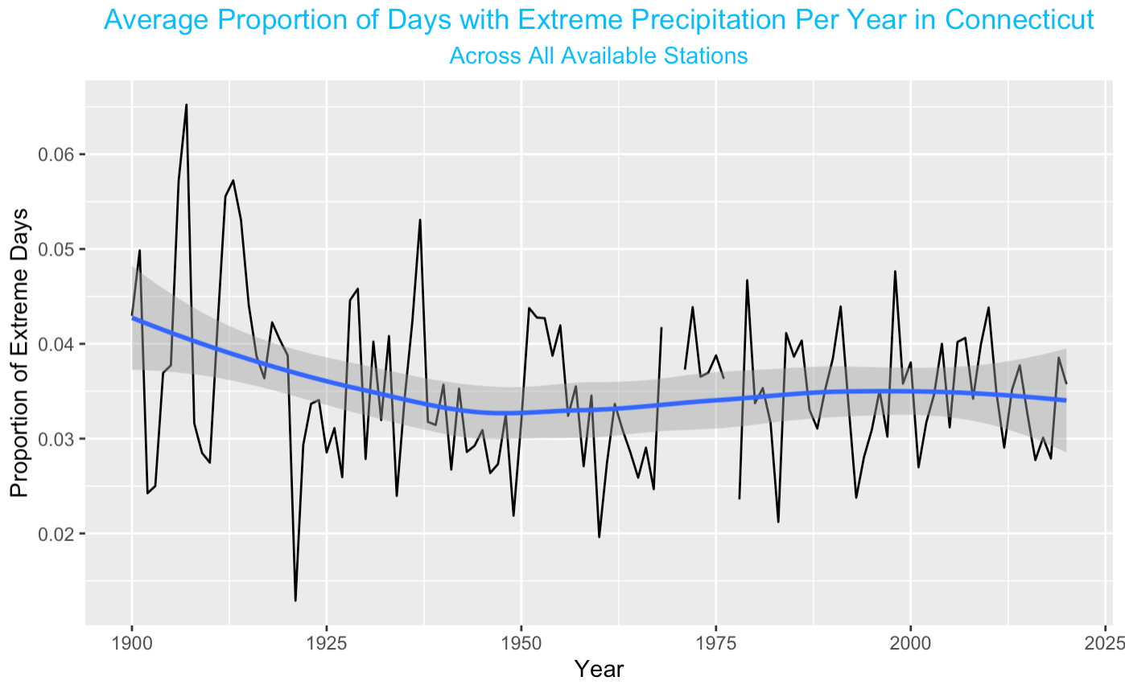
Proportion of days with extreme Precipitation

Slide 14
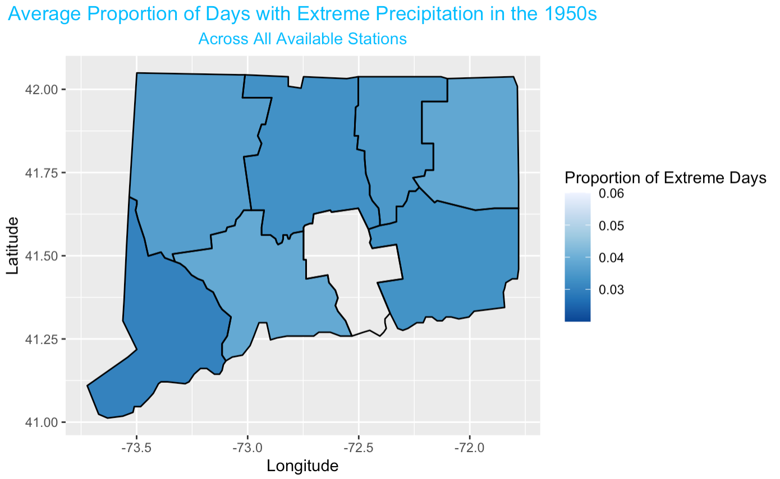
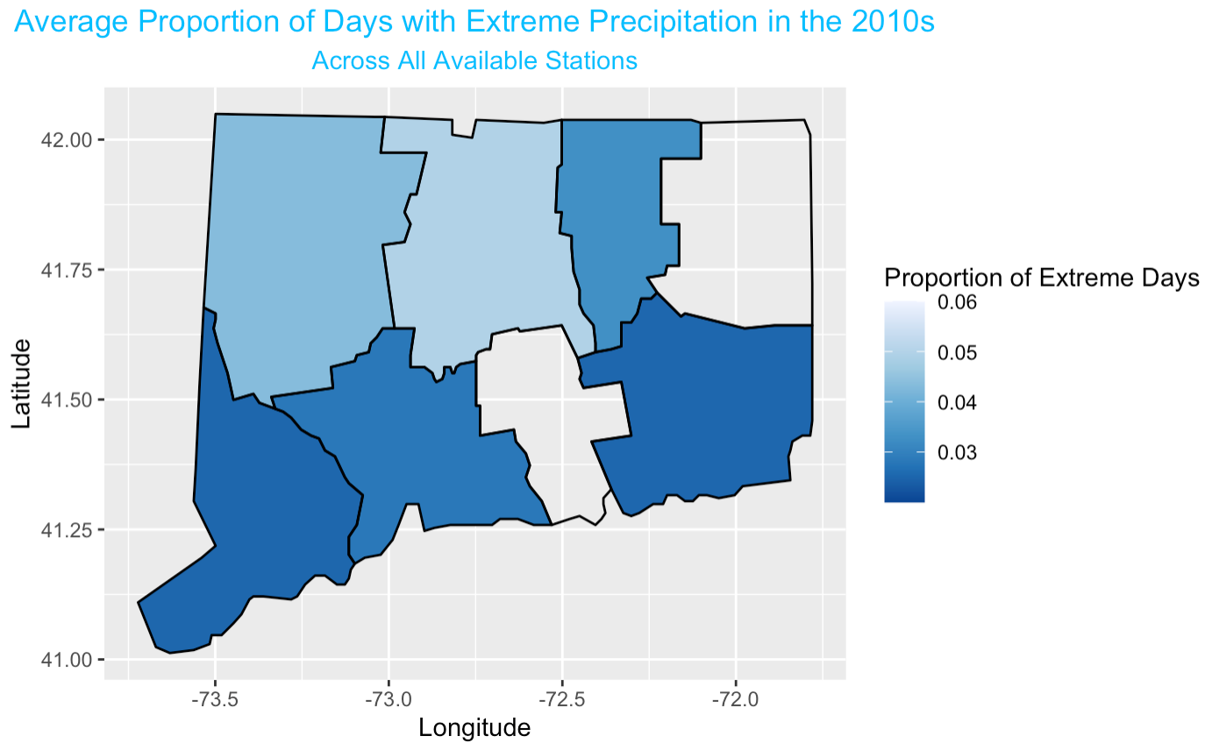
Map of Proportion of Extreme Days

Slide 15
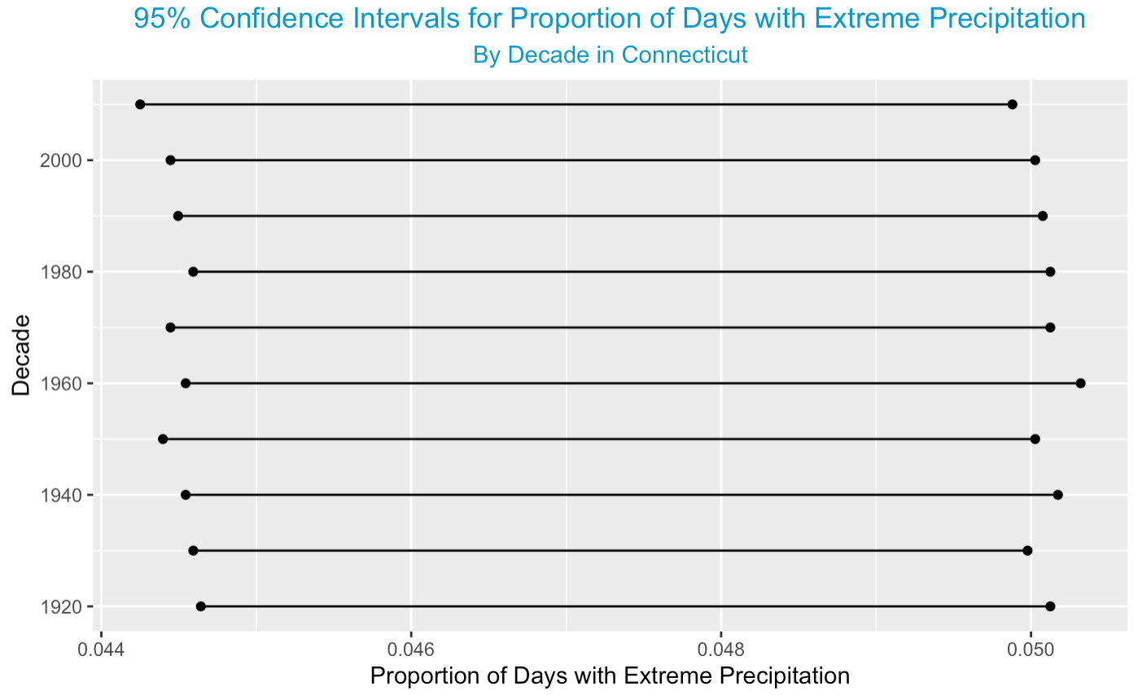
Confidence Interval: extreme Precipitation

Slide 16
Q3: Is there a connection between increasing air temperatures and extreme precipitation?

Slide 17
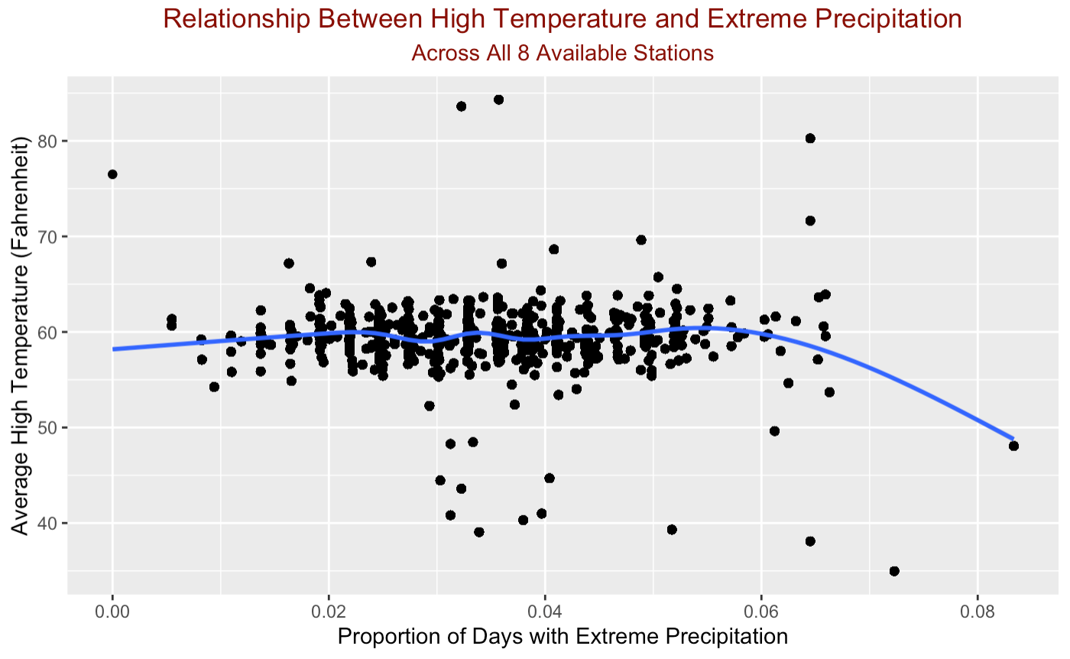
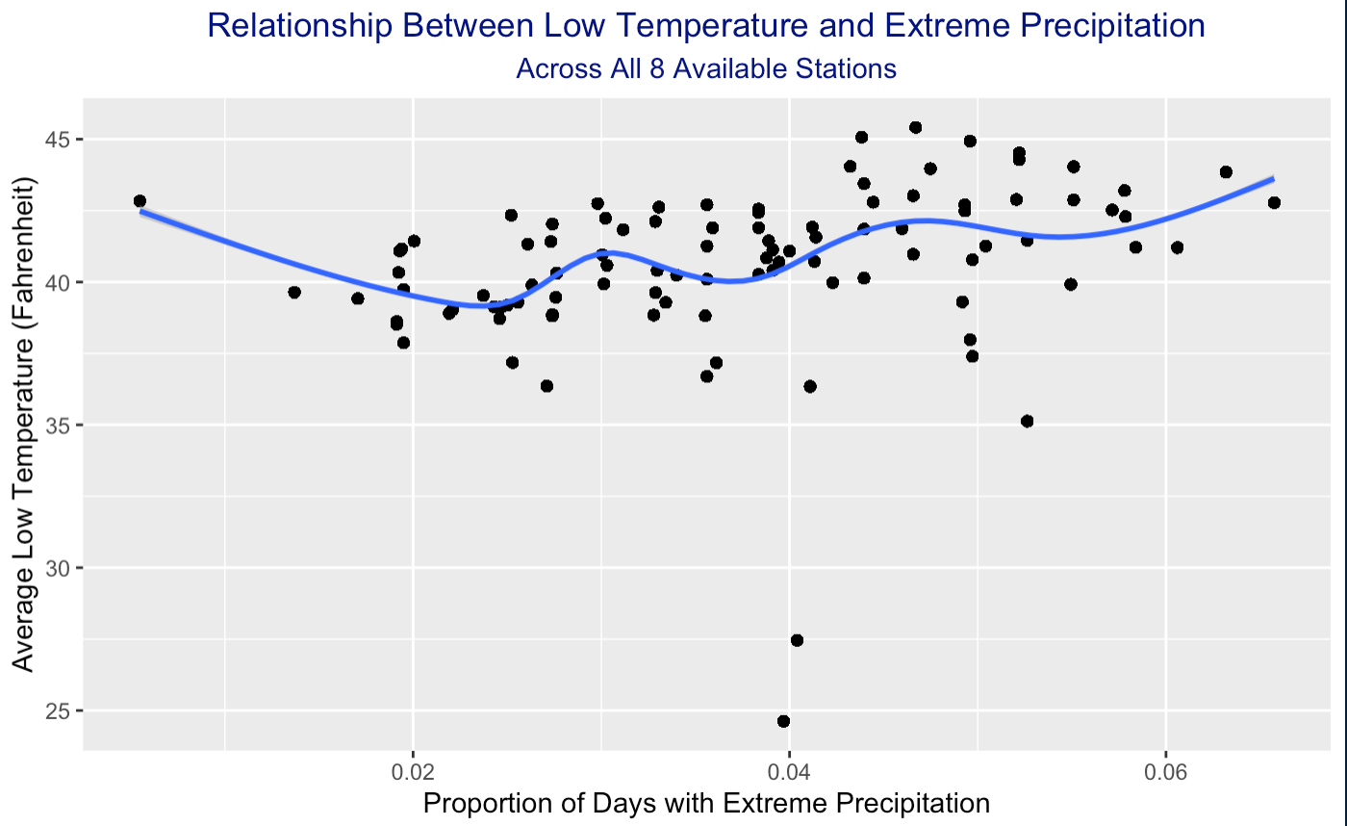
Weak Relationship Between Precipitation and Temperature
Correlation between high temperature and precipitation = -0.08
Correlation between low temperature and precipitation = -0.15

Slide 18
Conclusions
Evidence that average high + low temperatures are increasing in Connecticut
No evidence that extreme events are becoming more common
Weak link between both these phenomenon

Slide 19
Challenges
Original data was more comprehensive, but could not import into R
Missing data for some months threw off yearly averages
Had to adjust by looking at decades instead of single years
Adjusting scales on maps to make them match
Loops for confidence intervals

Slide 20
Further Suggestions
Use full country/more comprehensive data to repeat analysis
1
Combine with extreme weather data
2
Hurricanes, tornadoes, etc.
Combine with pollution data to identify causes of climate change
3
Examine specific times of the year to see if temperatures are changing or if there is more volatility in weather events
4

